Slide 1
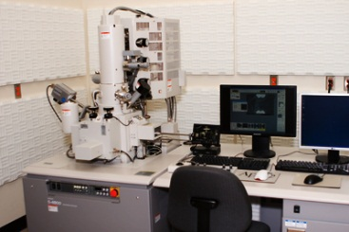
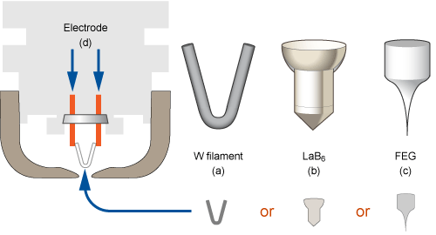
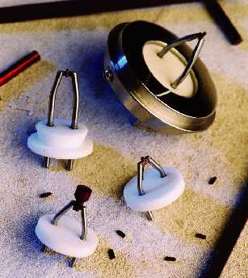
CAMTEC Nanofabrication Workshop
Scanning electron microscope (SEM)
ELECTRON SOURCES
Hitachi S-4800 field emission scanning electron microscope
Ruth Jaimes
2013

Slide 2
CAMTEC Nanofabrication Workshop
ELECTRON SOURCES
What is the main idea of SEM?
Electron gun
How is a fine electron bean formed?
Haw can we obtain an even finer electron bean?
What kinds of electron guns (electron sources) are used in the SEM?
What are the differences between the kinds of electrons guns?

Slide 3
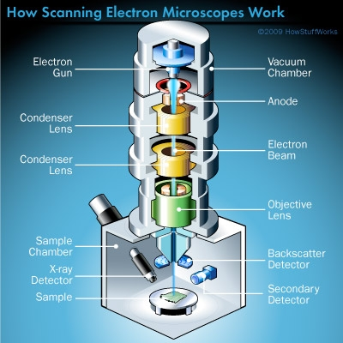
CAMTEC Nanofabrication Workshop
SEM ELECTRON SOURCES
What is the main idea of SEM?
Configuration of SEM
A scanning electron microscope (SEM) is a type of electron microscope that produces images with a focused beam of electrons.
The electrons interact with electrons in the sample
The electron gun are located either at the very top region of the SEM that generates a beam of electrons
The mechanism that emits electrons
form a metal and accelerates them
a strong electric field.
These electrons don't naturally go where they need to, however, which gets us to the next component of SEMs.
The electron beam is generation by electrons sources.

Slide 4
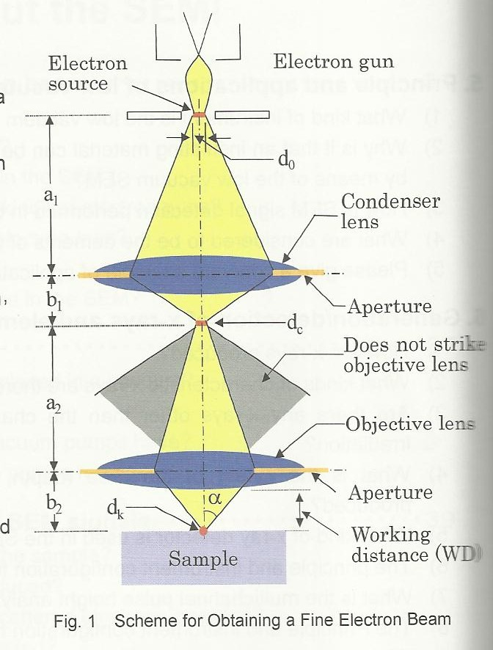
CAMTEC Nanofabrication Workshop
SEM ELECTRON SOURCES
How is a fine electron bean formed?
The electron source (diameter do) formed by electron gun is reduced and made into a fine electron bean (diameter dk) by the condenser lens and objective lens.
Haw can we obtain an even
finer electron bean?
In order to obtain a fine electron bean,
the instrument utilizes an electron gun featuring:
a small electron source,
a large current density (current (in A/cm²) per unit area, and
a small energy width (energy vitiating (in eV) of discharged electrons.

Slide 5
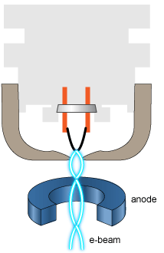
CAMTEC Nanofabrication Workshop
Why is important the electron sources?
generates a beam of electrons
The simplest and cheapest gun uses a heated tungsten wire to produce electrons.
Em um MEV típico, os elétrons são emitidos termionicamente a partir de um cátodo (filamento) de tungstênio ou hexaboreto de lantânio (LaB₆) e acelerados através de um ânodo, sendo também possível obter elétrons por efeito de emissão de campo. O tungstênio é tipicamente usado por ser o metal com mais alto ponto de fusão e mais baixa pressão de vapor, permitindo que seja aquecido para a emissão de elétrons.
What kind of electron sources is used in the SEM?
There are three types of electron gun according to the method of emission:
- field emission type (FE) electron gun,
- Schottky electron gun and,
- thermal electron gun.
Thermionic guns type, apply thermal energy to a filament (usually made of tungsten, which has a high melting point)
Field emission guns, create a strong electrical field to pull electrons away from the atoms.
- tungsten,
- LaB6 (lanthanum hexaboride)
- cold field emission,
- Schottky,
Notes:
“SEM electron sources – cold field emission, Shottky, tungsten, Lab6”

Slide 6
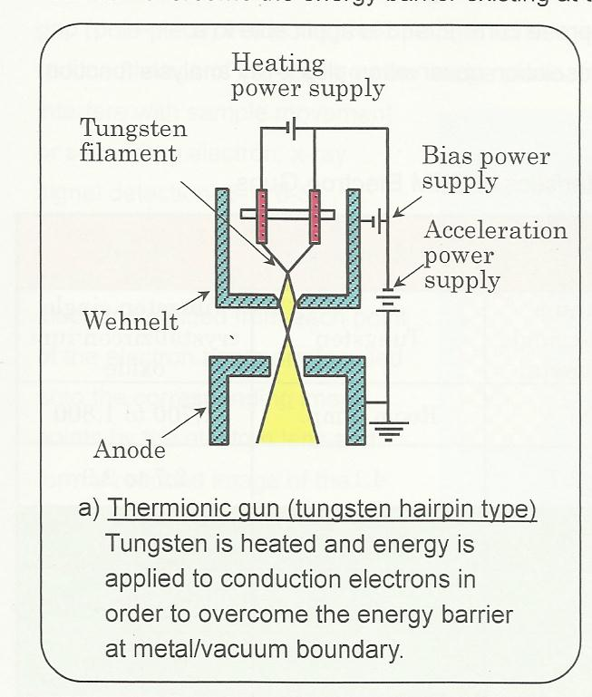
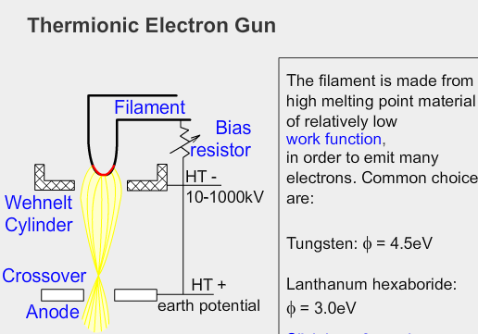
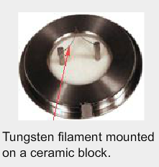
CAMTEC Nanofabrication Workshop
What kind of electron sources is used in the SEM?
(a) Thermionic gun (tungsten)

Slide 7
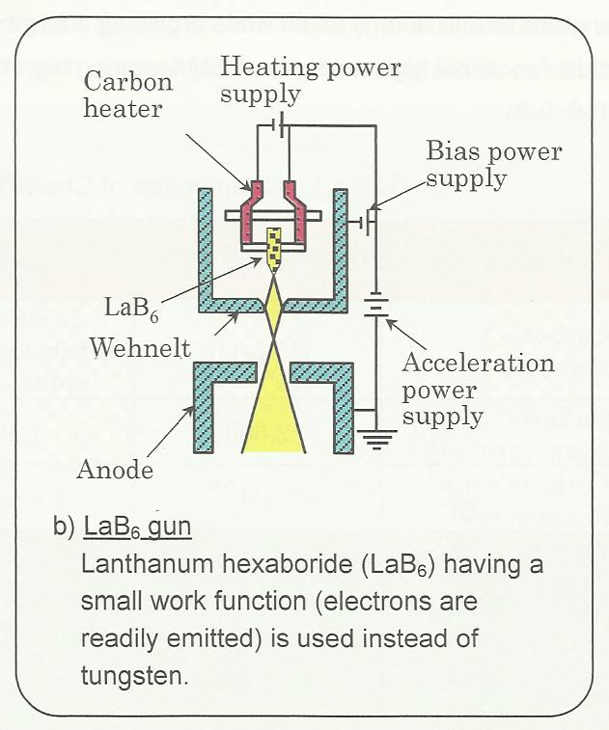
CAMTEC Nanofabrication Workshop
What kind of electron sources is used in the SEM?
(b) LaB6 gun

Slide 8
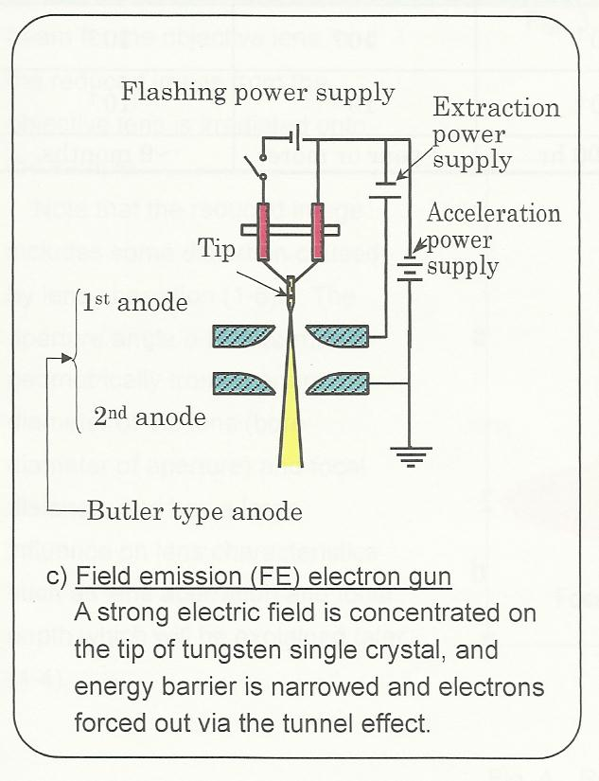
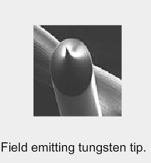
CAMTEC Nanofabrication Workshop
What kind of electron sources is used in the SEM?
(c) cold field emission (FE) electron gun

Slide 9
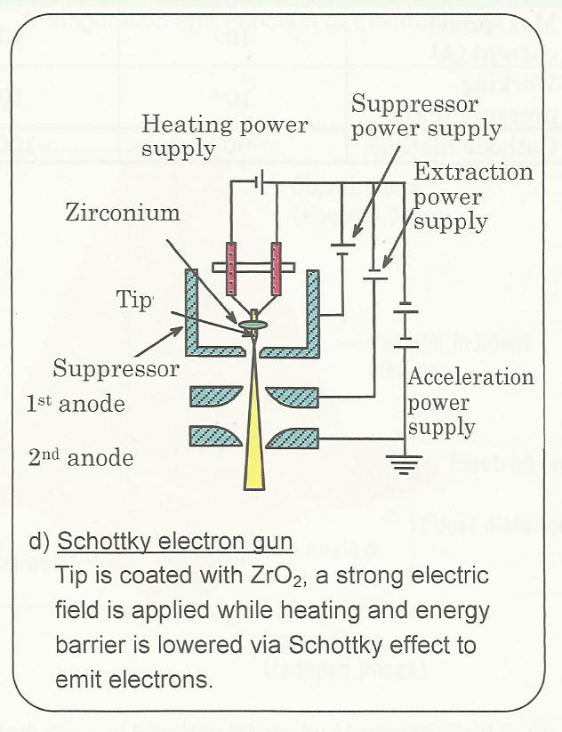
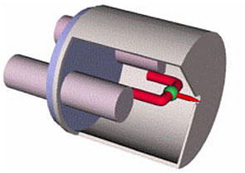
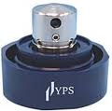
CAMTEC Nanofabrication Workshop
What kind of electron sources is used in the SEM?
(d) Schottky electron gun

Slide 10
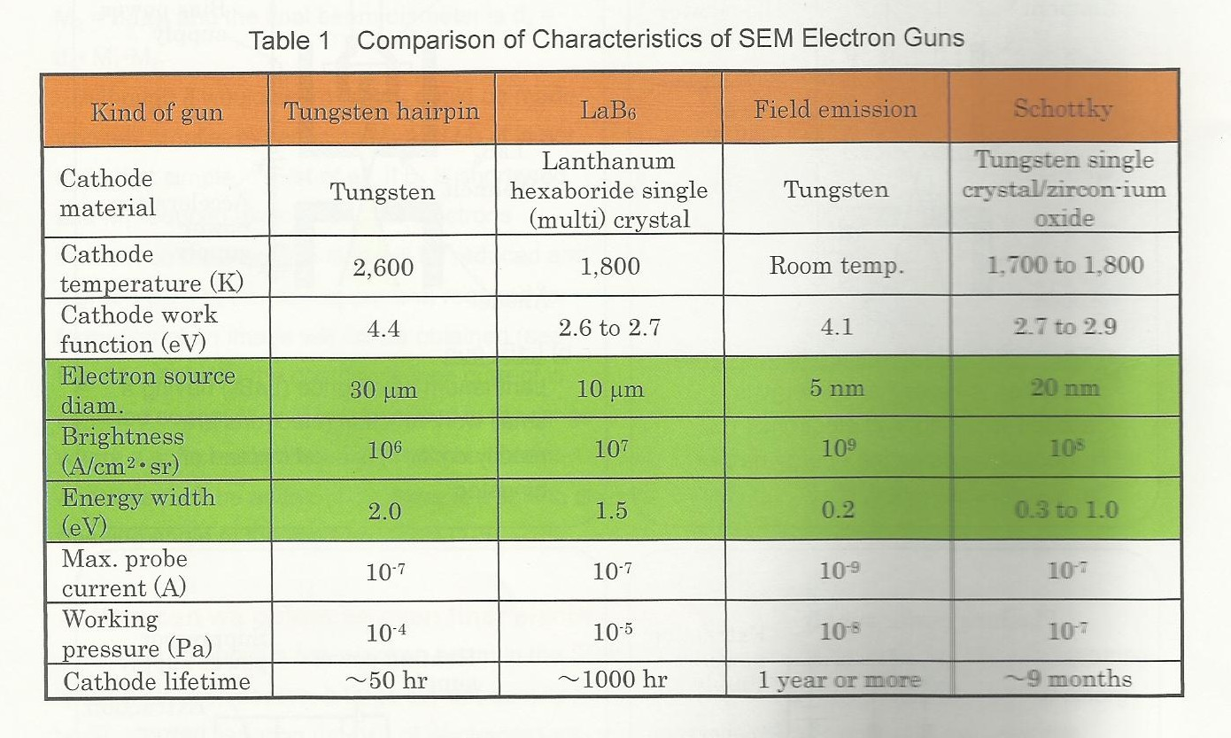
CAMTEC Nanofabrication Workshop
SEM ELECTRON SOURCES
What are the differences between the kinds of electrons guns?

Slide 11
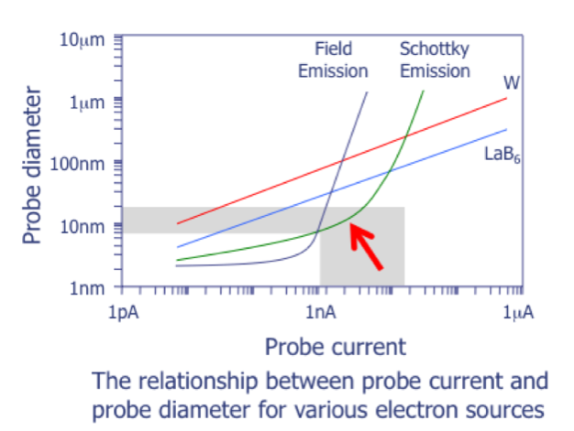
CAMTEC Nanofabrication Workshop

Slide 12
CAMTEC Nanofabrication Workshop
Thanks for attention
Canada
Victoria BC
Brazil

